Slide 1
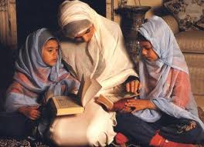
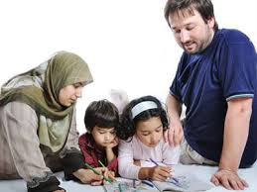
ALI 385 Nurturing your child’s Spirit in Islam: Session 4
Shahnaaz Alidina
March 2017

Slide 2
Agenda
Dealing with sensitive issues
Review of Syrian refugees
Group task on Introducing Quran to children of ages 3-6 and 6-12 years
Regroup and share
Some creative ideas
Signing the comments book

Slide 3
How to handle sensitive topics of sexuality
Q. What is an appropriate age to start discussing these issues that are sensitive?
Q. What are some basic tips that one should bear in mind when dealing with
Islam does not shun discussing on sexual topics however it paces the contents based on age appropriateness
As a parent we are being forced to discuss these issues earlier than we did before
As a parent you are the best person to educate your child on these matters with guidance from Islam.

Slide 4
Group 1 Discussion
Group 1: 3-6 years Quran topic: The story of the Elephants
Task: Discuss How would you creatively introduce this topic to this age group. Keeping in mind that children of this age love to take initiative, are eager to experiment, can work collaboratively with other children, learn easily through play and enjoy doing tasks.
Describe the lessons that you would want to drive home and the activities you might engage the child in.

Slide 5
Group 2 Discussion
Group 2: 6-12 years Quran topic: God’s creation of the Universe (look at clouds, mountains, seas, rivers etc)
Task: This age group are very industrious and are curious to know the ‘hows and whys of everything’. They take great pride in their own accomplishments and this period is good for nurturing the basis beliefs of Aqaid through understanding of creation.
How would you bring up this topic and develop it over time as they get to discover the wonders of

Slide 6
Regroup and share
Some good resources:
Al_Asr Ramadhan manuals
simplyislam.com (for story books on Quran )
Harun Yahya
Goodread books
Islamsearch.org videos (Quran and Modern science).

Slide 7
Building the discussion bit by bit
The Story of the Elephants
Power of Allah
The lessons derived.
The players in the story
Sura Memorization/Recitation
Engaging activities
Dress up and act
Art activity
Visit to Safari park
National geography on Elephants
Reading a story book
Stepping inside the story
Sounds that elephants make. Why their long nose. The purpose of this nose etc

Slide 8
In summary
Quran lessons should be part of normal home discussions.
Strike the moment when it is right. For example when a case of bullying come up then talk of the story of Yusuf and his siblings.
Talk high of the Allah’s book so that our children feel the importance and relevance of it. Make it the family’s companion manual.
Like all other learning Quran learning happens if we plan, research and help our children understand it

Slide 9
The weight of clouds
https://www.youtube.com/watch?v=HG9O1MCfx-s
I would recommend this for 6-12yrs. Based on the age and capability of your child you can simplify or challenge after viewing this to engage in conversation on the creation of Allah.

Slide 10
Enjoy parenting, its Allah’s greatest gift, remember…

